Slide 1
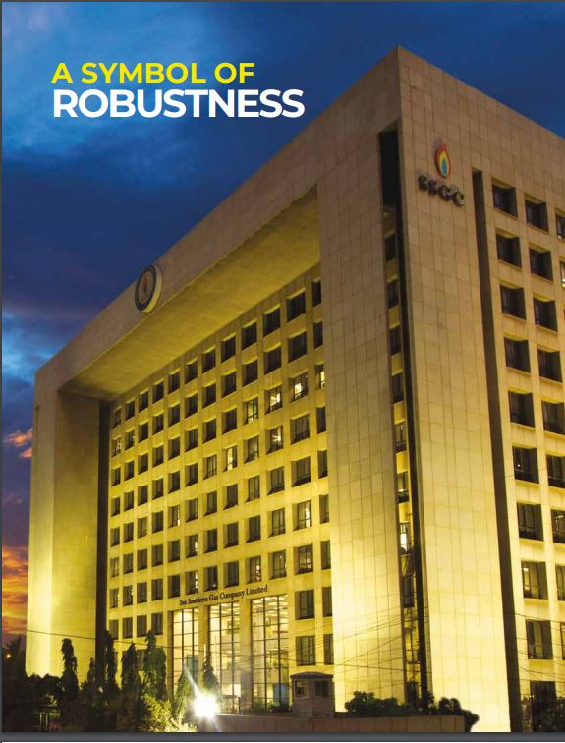


CORPORATE BRIEFING
Notes:
Animated spinning picture
(Intermediate)
Tip: Some shape effects on this slide are created with the Combine Shapes commands. To access this command, you must add it to the Quick Access Toolbar, located above the File tab. To customize the Quick Access Toolbar, do the following:
Click the arrow next to the Quick Access Toolbar, and then under Customize Quick Access Toolbar click More Commands.
In the PowerPoint Options dialog box, in the Choose commands from list, select All Commands.
In the list of commands, click Combine Shapes, and then click Add.
To reproduce the shape effect on this slide, do the following:
On the Home tab, in the Slides group, click Layout, and then click Blank.
Also on the Home tab, in the Drawing group, click Shapes, and then under Basic Shapes click Oval (first row).
On the slide, drag to draw an oval.
Select the oval. Under Drawing Tools, on the Format tab, in the Size group, enter 6” in the Height box and 6” in the Width box.
Also on the Format shape, in the Shape Styles group, click Shape Outline, and then click No Outline.
On the Home tab, in the Drawing group, click Shapes, and then under Basic Shapes click Pie (second row).
On the slide, drag to draw a pie.
Select the pie. Drag the yellow diamond adjustment handle to create a wedge shape.
Under Drawing Tools, on the Format tab, in the Size group, enter 5.7” in the Height box and 5.7” in the Width box.
Press and hold CTRL, select the oval, and then select the pie. On the Home tab, in the Drawing group, click Arrange, point to Align, and then do the following:
Click Align to Slide.
Click Align Center.
Click Align Middle.
Press and hold CTRL, and then select the oval and then the pie shape. On the Quick Access Toolbar, click Combine Shapes, and then click Shape Subtract.
Select the new shape. Under Drawing Tools, on the Format tab, in the Shape Style group, click the Format Shape dialog box launcher. In the Format Shape dialog box, click Fill in the left pane, in the Fill pane, click Picture or texture fill, and then click the button next to Texture and click Recycled Paper (third row).
Also in the Format Shape dialog box, click Picture Color in the left pane, in the Picture Color pane, under Recolor, click the button next to Presets, and then click Grayscale (first row).
Also in the Format Shape dialog box, click Picture Corrections in the left pane, in the Picture Corrections pane, under Brightness and Contrast, in the Contrast box, enter 20%.
Also in the Format Shape dialog box, click Shadow in the left pane, in the Shadow pane, click the Presets button, and then under Outer, click Offset Diagonal Bottom Left.
Also in the Shadow pane, in the Blur box, enter 10 pt.
To reproduce the picture effects on this slide, do the following:
On the Insert tab, in the Images group, click Picture. In the Insert Picture dialog box, select a picture and then click Insert.
Select the picture. Under Picture Tools, on the Format tab, in the Size group, click the Size and Position dialog box launcher. In the Format Picture dialog box, resize or crop the image so that the height is set to 5.8” and the width is set to 5.8”. To crop the picture, click Crop in the left pane, and in the right pane, under Crop position, enter values into the Height, Width, Left, and Top boxes. To resize the picture, click Size in the left pane, and in the right pane, under Size and rotate, enter values into the Height and Width boxes.
Under Picture Tools, on the Format tab, in the Size group, click the down arrow under Crop, and then click Crop to Shape. Under Basic Shapes, click Oval (first row, first option from the left).
Also under Picture Tools, on the Format tab, in the Arrange group, click Send Backward.
To reproduce the other shapes on this slide, do the following:
Also on the Home tab, in the Drawing group, click Shapes, and then under Basic Shapes click Oval (first row).
On the slide, drag to draw an oval.
Select the oval. Under Drawings Tools, on the Format tab, in the Size group, enter 0.17” in the Height box and 0.17” in the Width box.
Also on the Format tab, in the Shape Styles group, click Shape Fill, and then under Theme Colors, click Black, Text 1, Lighter 25% (fourth row).
Also on the Format tab, in the Shape Styles group, click Shape Outline, and then click No Line.
On the Home tab, in the Drawing group, click Shapes, and then under Basic Shapes click Donut.
On the slide, drag to draw a donut.
Select the donut. Under Drawing Tools, on the Format tab in the Size group, enter 0.25” in the Height box and 0.25” in the Width box.
Also on the Format tab, in the Shape Styles group, click the Format Shape dialog box launcher. In the Format Shape dialog box, click Fill in the left pane, in the Fill pane, click Gradient fill, and then click the button next to Preset colors and click Silver (fifth row).
Also in the Format Shape dialog box, click Line Color in the left pane, in the Line Color pane, click No line.
Also in the Format Shape dialog box, click 3-D Format in the left pane, in the 3-D Format pane, under Bevel, click the button next to Top, and then click Circle (first row).
Press and hold CTRL, and then select the freeform shape, the picture, the small circle, and the donut. On the Home tab, in the Drawing group, click Arrange, point to Align, and the do the following:
Click Align to Slide.
Click Align Center.
Click Align Middle.
Also on the Home tab, in the Drawing group, click Shapes, and then under Basic Shapes click Oval.
On the slide, drag to draw an oval.
Select the oval. Under Drawing Tools, on the Format tab, in the Size group, enter 0.65” in the Height box and 0.65” in the Width box.
Also on the Format tab, in the Shape Styles group, click the Format Shape dialog box launcher. In the Format Shape dialog box, click Fill in the left pane, in the Fill pane, click Picture or texture fill, and then click the button next to Texture and then click Recycled Paper (fourth row).
Select the freeform shape. On the Home tab, in the Clipboard group, click Format Painter, and then click the new oval.
Position this circle over the top edge of the freeform shape.
On the Home tab, in the Drawing group, click Arrange, and then do the following:
Under Order Objects, click Send to Back.
Point to Align, and then click Align Center.
To reproduce the animation effects on this slide, do the following:
Select the picture. On the Animations tab, in the Advanced Animation group, click Add Animation, and then under Emphasis Effects, click Spin.
Also on the Animations tab, in the Animation group, click the Show Additional Effects Options dialog box launcher. In the Spin dialog box, on the Effect tab, do the following:
In the Smooth start box, enter 5 sec.
In the Smooth end box, enter 5 sec.
Also in the Spin dialog box, click the Timing tab, and then do the following:
In the Start list, select With Previous.
In the Duration box, enter 20 sec.
Select the small oval at the top edge of the freeform shape. On the Animations tab, in the Advanced Animation group, click Add Animation, under Motion Paths, click Shapes.
On the slide, drag the bottom, left, and right sides of the motion path so that it matches the inside edge of the freeform shape.
Also on the Animations tab, in the Animation group, click the Show Additional Effects Options dialog box launcher. In the Circle dialog box, on the Effect tab, do the following:
In the Smooth start box, enter 5 sec.
In the Smooth end box, enter 5 sec.
Also in the Spin dialog box, click the Timing tab, and then do the following:
In the Start list, select With Previous.
In the Duration box, enter 20 sec.
To reproduce the background effects on this slide, do the following:
On the Design tab, in the Background group, click Background Styles, and then click Style 9.

Slide 2
CORPORATE BRIEFING
01
FINANCIAL INFORMATION
STRATEGIC / OPERATIONAL DEVELOPMENTS
02
03
OTHER INFORMATION
04
QUESTION & ANSWER SESSIONS
2

Slide 3
CORPORATE BRIEFING
FINANCIAL INFORMATION
01
3

Slide 4
OUR FINANCIALS – SNAPSHOT FY 2020-21
Profit / (Loss) after Tax:
2021: PKR 1,956 million
2020: PKR (21,393) million
109%
Growth YoY
Earning per Share:
2021: PKR 2.2
2020: PKR (24.28)
109%
Growth YoY
Turnover:
2021: PKR 271,487 million
2020: PKR 251,800 million
7.8%
Growth YoY
Unaccounted for Gas:
2021: 15.31%
2020: 17.25%
2% UFG
Reduction YoY (11%)
Capitalization:
2021: PKR 11,319 million
2020 : PKR 9,598 million
18%
Growth YoY
Working Capital
2021: PKR (5,431) million
2020: PKR 27,050 million
Bank Loans
2021: PKR 53,091 million
2020: PKR 52,154 million
1.2 times
Reduction YoY
2%
Growth YoY
4

Slide 5
OUR FINANCIALS – SNAPSHOT-Q1 – FY 2021-22
Profit / (Loss) after tax:
Q1 FY 2022: PKR 736 million
Q1 FY 2021: PKR (721) million
202%
Growth YoY
Earning per Share:
Q1 FY 2022: PKR 0.84
Q1 FY 2021: PKR (0.82)
202%
Growth YoY
Turnover:
Q1 FY 2022: PKR 79,995 million
Q1 FY 2021: PKR 63,162 million
27%
Growth YoY
Unaccounted for Gas:
Q1 FY 2022: 13.75%
Q1 FY 2021: 14.02%
0.27%
Reduction YoY
Capitalization:
Q1 FY 2022: PKR 902 million
Q1 FY 2021: PKR 1,242 million
27%
Reduction YoY
Working Capital
Q1 FY 2022:
PKR 3,685 million
Q1 FY 2021: PKR(10,351) million
Bank Loans
Q1 FY 2022:
PKR 50,796 million
Q1 FY 2021:
PKR 60,872 million
1.36 times
Increase YoY
17%
Reduction YoY
5

Slide 6
GROWTH
2022
2021
2020
2019
Trans. (KMs): 4,143
Dist. (KMs): 49,098
No. of Consumer (million): 3.2+
Trans. (KMs): 4,143
Dist. (KMs): 48,449
No. of Consumer (million): 3.2+
Trans. (KMs): 4,126
Dist. (KMs): 47,520
No. of Consumer (million): 3.1+
Trans. (KMs): 4,054
Dist. (KMs): 46,993
No. of Consumer (million): 3.0+
2018
2017
Legend:
Trans. (KMs): Transmission Network in Kilometres
Dist. (KMs): Distribution Network in Kilometres
No. of Consumers (million): Industrial, Commercial and Domestic consumers
Trans. (KMs): 4,030
Dist. (KMs): 46,210
No. of Consumer (million): 2.9+
Trans. (KMs): 3,973
Dist. (KMs): 45,521
No. of Consumer (million): 2.8+
6

Slide 7
SHAREHOLDING STRUCTURE
% Break-up of 880,916,309 Shares
7

Slide 8
SERVING THE COUNTRY
8

Slide 9
SERVING THE COUNTRY – SALES MIX (2023-9M)
*
830 MMSCFD
* Power, CNG and few industrial & commercial customers partially consume RLNG.
9

Slide 10
CORPORATE BRIEFING
STRATEGIC / OPERATIONAL DEVELOPMENTS
02
10

Slide 11
REDUCTION IN UNACCOUNTED FOR GAS (UFG)
UFG is planned to be reduced to 45 BCF by the end of FY 2022-23. UFG has been drastically reduced from 78 BCF to 52 BCF in last 5 years (up to FY 2021-22) due to rigorous implementation of UFG reduction plan as follows:
Network management in Karachi through establishment of 22 zones;
TBS Automation project is in full-swing;
Unauthorized users are being brought under unauthorized gas claim framework. As of date, raised claims worth PKR 1 Billion;
Right-sizing, metering-accuracy and EVC installation for large scale industrial consumers is being pursued on-priority through adequate progress on the monthly and quarterly plans;
Engagement of Third Party Contractor for pressure surveys of high rise buildings. This would bring saving of around 500 MMCF in UFG; and
In Quetta, door-to-door survey is being conducted to collect evidence of parameters impacting monthly billing which has resulted in UFG saving of 5 BCF.
IMPACT OF BALOCHISTAN
Region | FY. 2020-21 |  | FY. 2019-20
 | UFG Vol. | UFG % | UFG Vol. | UFG %
Karachi | 21,302 | *9.6% | 36,106 | 14.0%
Interior Sindh | 10,688 | 15.1% | 11,794 | 15.5%
Trans. Gain | (729) | - | (4,320) | -
UFG W/o Balochistan | 31,261 | 12.0% | 43,580 | 14.9%
Balochistan | 24,297 | 51.3% | 25,056 | 49.8%
UFG with Balochistan | 55,557 | 15.3% | 68,626 | 17.2%
* Since Oct 2022, UFG in Karachi is at 8%.
11

Slide 12
INTER-ENTERPRISE LIABILITIES
CIRCULAR DEBT - RECENT DEVELOPMENTS
PAKISTAN STEEL MILLS CORPORATION (PRIVATE) LIMITED
On directions of MoE (Petroleum Division), settlement of admitted liabilities of PSML of Rs. 48 billion i.e. Principal and admitted LPS has been agreed between SSGC and PSML.
For settlement, SSGC agreed for allocation of PSML Land of same value in lieu of PSML liabilities towards SSGC on lease basis for 60 years.
Currently, the matter is in mature stages and after its finalization SSGC will amend its legal suit against PSML and provide NOC to PSML only to the extent of 1229 acres of land and Core Operating Assets in lieu of settlement of SSGC receivables.
Accordingly, LPS will be accounted in the Financial Statements for which coordination is being made with OGRA to allow LPS as non-operating income.
OGRA to allow Return on Land is also one of the options.
K-ELECTRIC LIMITED
In June 2022, a Task Force was constituted by the Prime Minister under the Chairmanship of Mr. Shahid Khaqan Abbasi to resolve issues / disputes related to K-Electric;
Task Force decided to enter into a multi-party Mediation Agreement in order to resolve KE’s receivables and payables issues between all the stakeholders;
Mediation Agreement has been shared by Ministry of Energy (MoE) with all stakeholders;
SSGC after having a legal opinion on Mediation Agreement and Board in-principal approval, given consent for going ahead with Mediation Agreement.
12

Slide 13
MATTERS PENDING WITH OGRA
RLNG VOLUME HANDLING
The Company has a claim of Rs. 81 Billion on account of RLNG Volume handling claim up to FY 2021-22. This claim is in accordance with ECC Guideline to OGRA and pending OGRA appointed Consultant Report
Economic Coordination Committee of the Cabinet (ECC) in its meeting dated May 11, 2018 approved the summary submitted by the Petroleum Division under which the Company was allowed UFG based on RLNG handling basis (volumetric basis) in the Sale Price of RLNG in the form of Distribution loss due to swapping arrangements.
To sort out this issue, ECC constituted a Committee comprising of Secretaries of Petroleum & Finance. In line with Committee recommendations and having an independent view as requested by the Company, OGRA hired the services of International Technical, Commercial and Management Auditors for determining actual UFG of Gas Companies in respect of indigenous gas as well as imported RLNG.
REALIZABILITY OF RECEIVABLES FROM SNGPL BASED ON OGRA CONSULTANT REPORT
OGRA has appointed a Consultant to determine the inter-enterprise liabilities of both Sui Companies before June 2020, the report of which is yet to be received.
TARIFF ADJUSTMENTS
As at June 30, 2021, receivable on account of Tariff adjustment against Indigenous Gas stands at Rs. 208 Billion which is to be realized on increase in customer tariffs by OGRA.
13

Slide 14
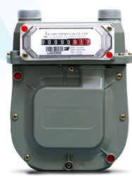

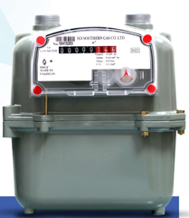
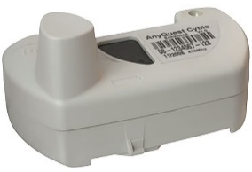
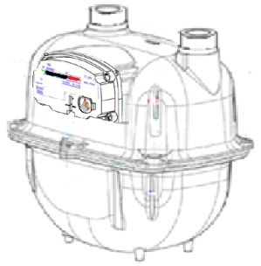
METER MANUFACTURING PLANT
SSGC owns and operates the only Domestic Gas Meters Manufacturing Plant in Pakistan with substantial vertical integration in-house.
The plant is based on state of the art technology and is capable for producing up to 1 million units annually, on single shift basis.
Milestone Achieved:
Recently, SSGC has achieved a major milestone on account of technology transfer to locally produce the Measuring Unit for G-4 gas meters which was being imported earlier for 3rd Gen of G-4 Domestic Gas Meters.
The first batch of fully locally assembled as aforesaid has passed the quality standards and meet the European standards ANSI 109.1, BS EN 1359:2017 and OIML-R137-1-2-e12.c
G-1.6 Gas Meter
AMR enabled G-4 Gas Meter
G-6 Gas Meter (Next Target)
14

Slide 15
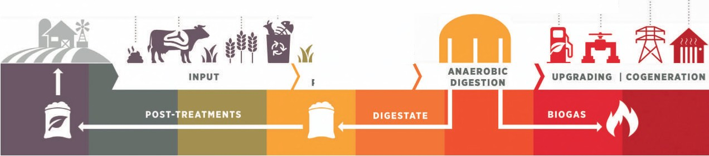
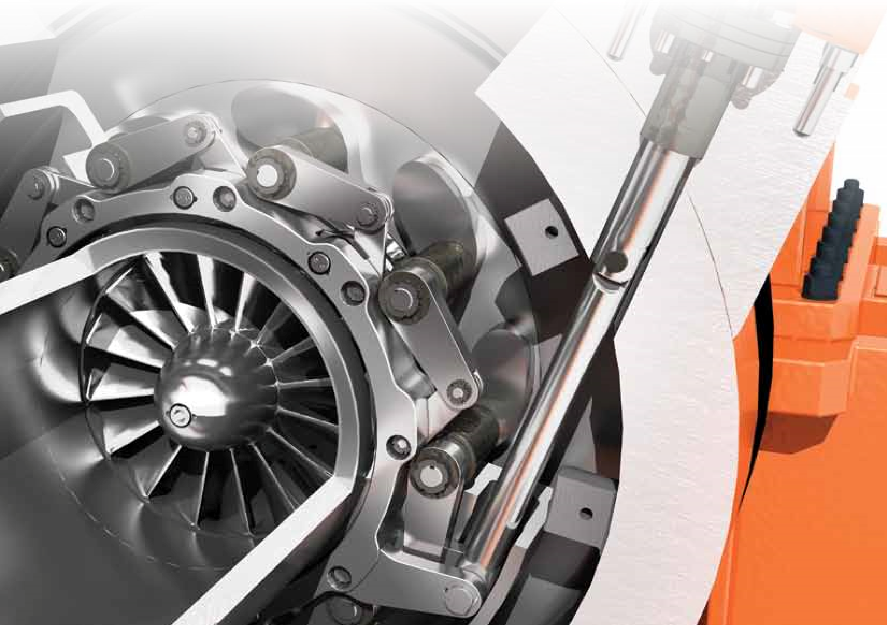
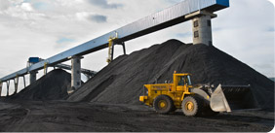
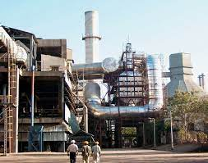
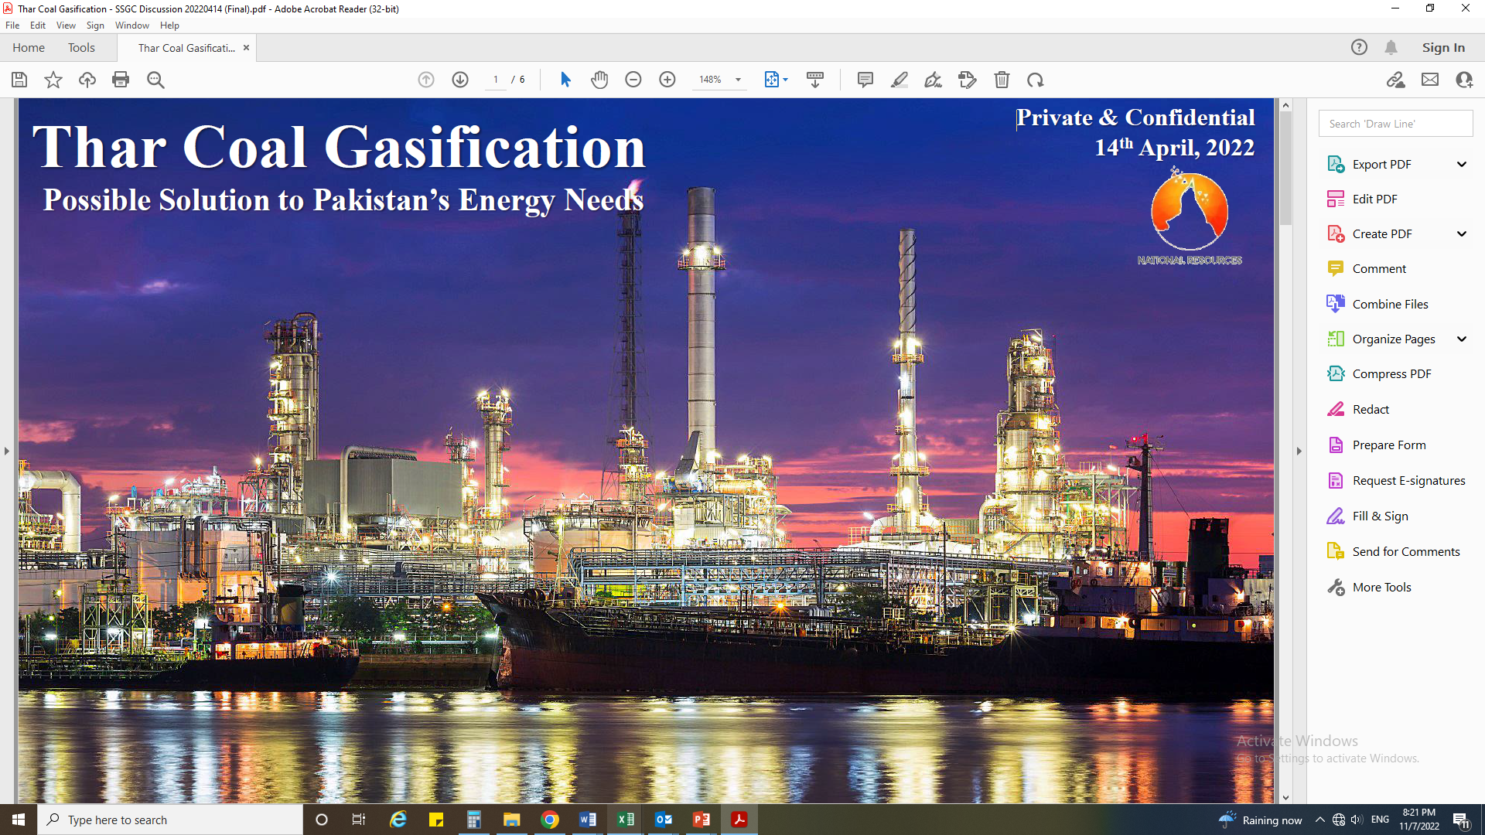
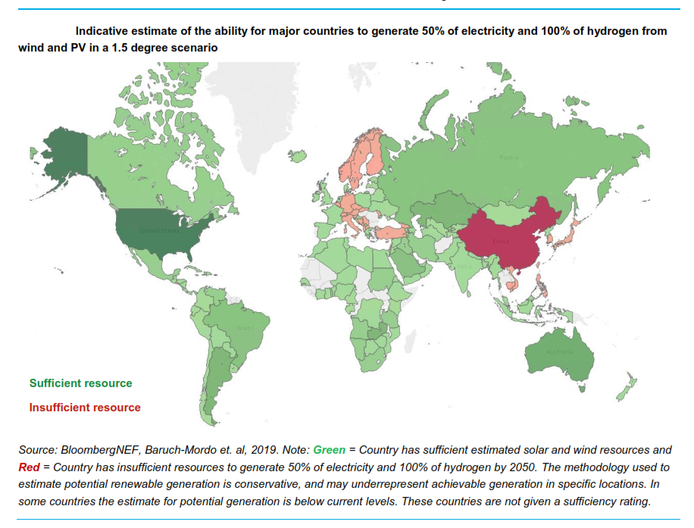
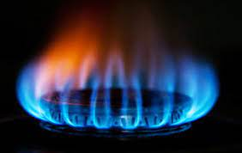
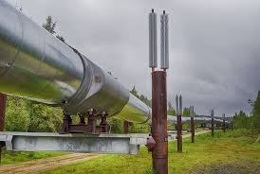
SSGC AE – New Venture
Bringing Unallocated Gases to consumers on competitive terms
Nitrogen Production for optimization of gas specifications in exchange of natural gas for intelligent utilization
Purchase of Biogas/ Biomethane (RNG) – BOO Model
Power Generation at SMSs – Pressure Harnessing Method
Production & Sale of Renewable Hydrogen – Green Fuel
Power Generation from Waste – WHRS Method
Coal to Gas (C2G) and Coal to Liquid (C2L)
15

Slide 16
SSGC LPG (PVT) LIMITED
ACCOMPLISHMENTS
SLL started its own imports in February 2020 and has grown its volumes in terms of imports
Net Equity has increased three times in last Five Years
In last nine months specially in winters SLL has shown a significant growth in terms of imports and has become the leading LPG importer in Pakistan
Market Share – Led the Terminal business with 64% share and improved the LPG sale market from 2.5% to 7 %
SLL, in Dec 2022, opened a Brand Shop in DHA Karachi to showcase different sizes of cylinders and Safety literature that can help consumer to use it safely. This shop will also be an avenue to take orders from the walk-in customers; Established 2 warehouses and arranged 6 delivery vans for Home Delivery (HD) in Karachi
SSGC’s help line has been used 24/7 to take orders in addition to the SLL website/app where the orders can directly be placed
Social media presence enhanced thru LinkedIn, FB, Instagram
SLL has signed an agreement with SNGPL for supply of 100,000 cylinders and LPG at various bottling plants in SNGPL’s franchise area on Ministry’s instructions. 59,003 cylinders filled with LPG already provided in last 4 months
HD thru the above efforts has already increased the sale from 100 MT (2022) to 250 MT (HY2023)
Established foot print in Quetta for the first time.
SLL imported Pakistan’s largest ever LPG Vessel that brings 9,500 tons of LPG thru a new supplier
Pre-selling concept introduced to generate cash flows and to create ullage for frequent larger Vessels handling
SLL approached PPRA thru Ministry of Petroleum and was able to secure exemptions from certain PPRA rules (for winter season) which has eased and sped up the procurement process in a highly volatile pricing environment. Additionally Open Framework has been opted which would facilitate the procurement process even after the exemptions from PPRA rules not available after March ‘23.
 | FY2022 Actual | FY2023 Target | FY2023 Actual March
Terminal Volume (MT) | 58,089 | 124,680 | 124,656
LPG Sales Volume (MT) | 42,768 | 65,000 | 86,386
Market Share – Terminal Business | 48% | 50% | 65%
Market Share – LPG Sale | 2.5% | 5.62% | 6.9%
16

Slide 17
CORPORATE BRIEFING
OTHER INFORMATION
03
17

Slide 18
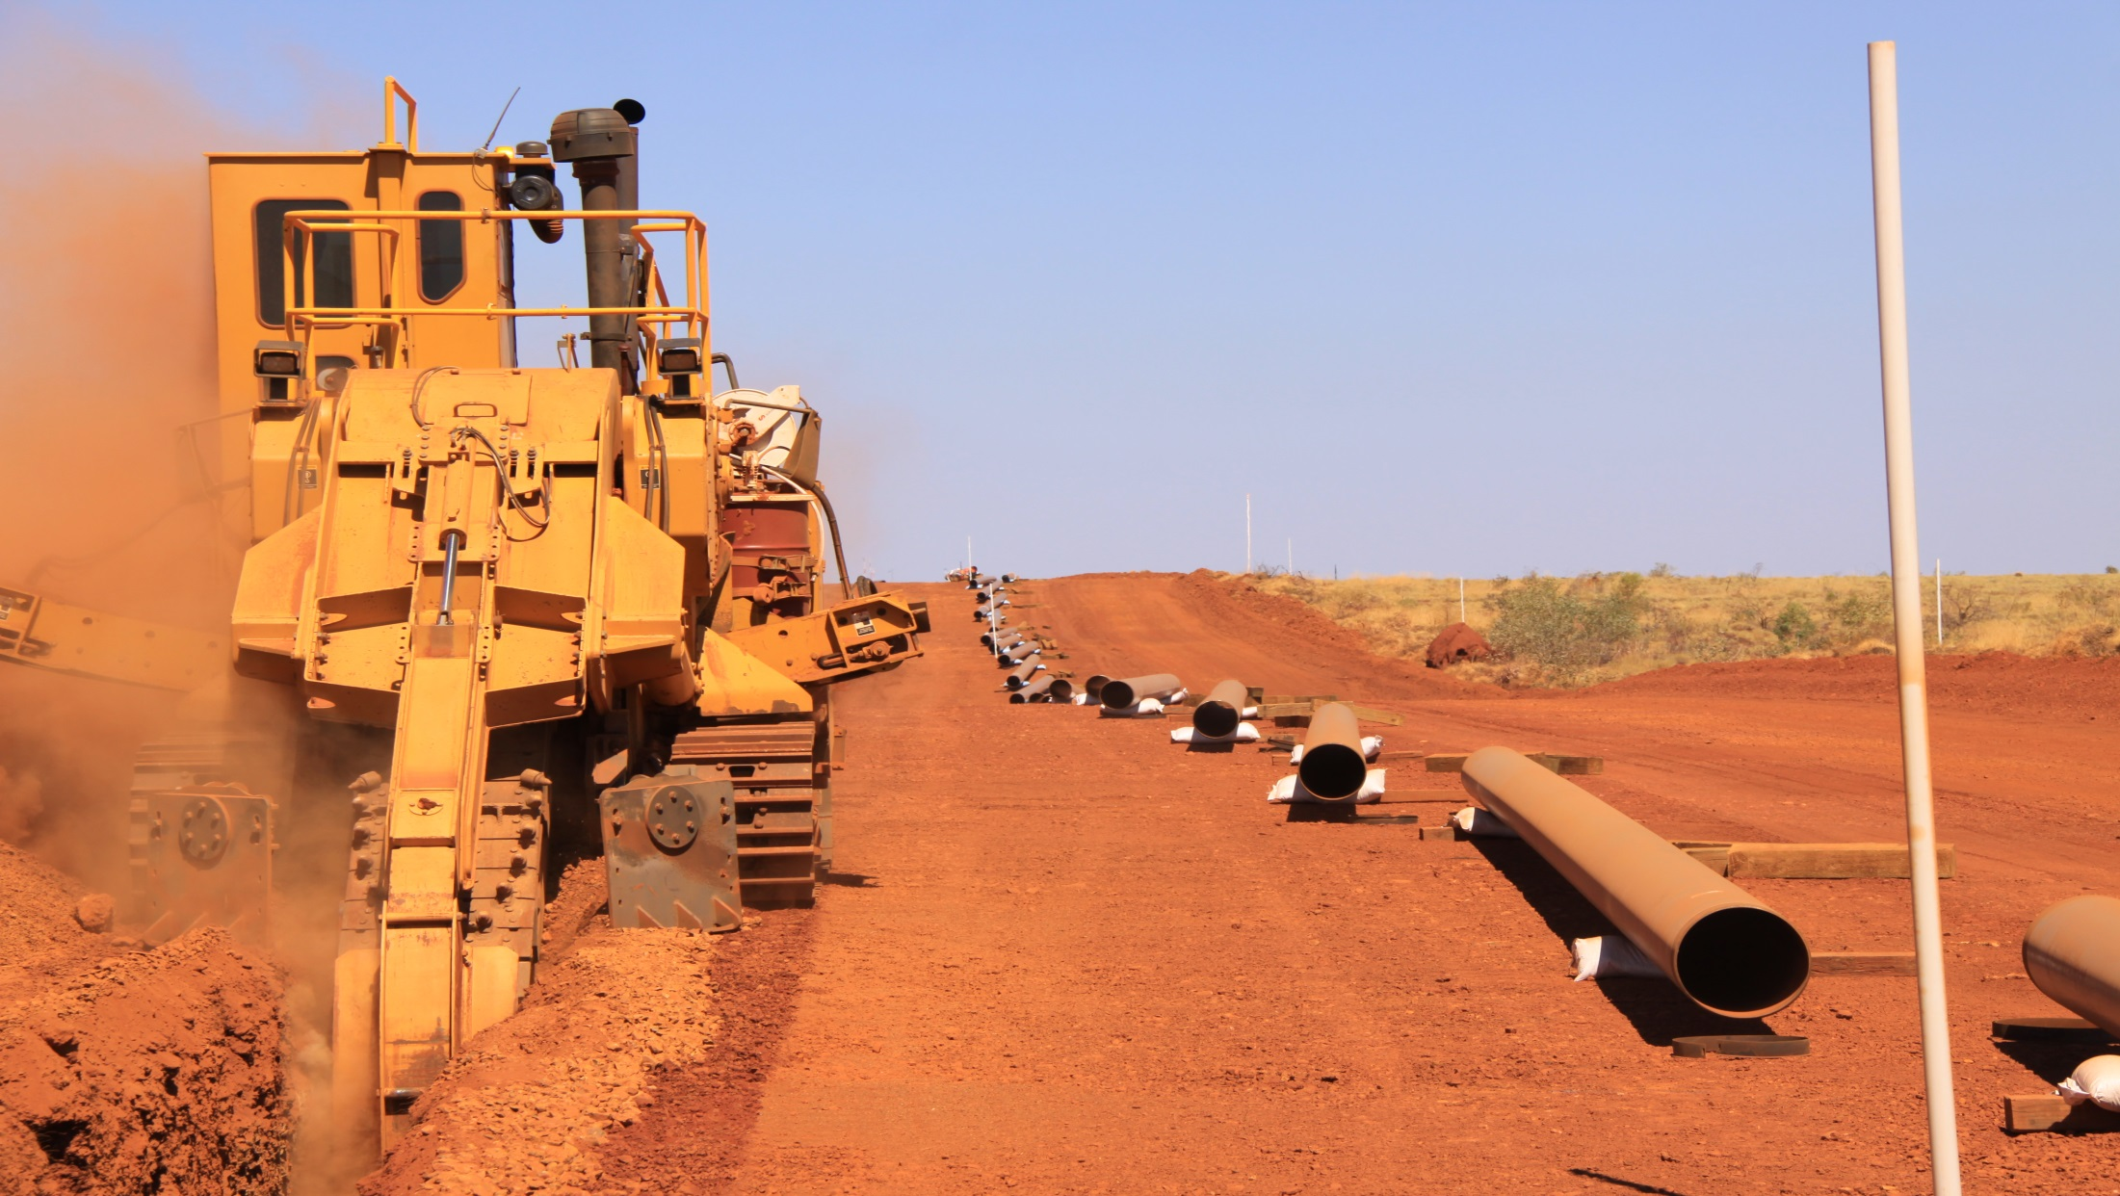
COMPANY OVERVIEW
CORE BUSINESS:
Transmission, Distribution and Sale of Natural Gas
Design & Construction of Transmission / Distribution Projects
Re-gasified LNG
NON-CORE BUSINESS:
LPG/NGL/Condensate
Manufacturing Domestic Gas Meters
SUBSIDIARIES:
SSGC LPG
SSGC AE
Integrated National Gas T&D Operator | 3.2 million Consumers | 336 BCF Annual Supply
69 year of experience in O&M of gas T&D system | Transmission Network of 4,143 KMs | Distribution Network of 49,098 KMs
8 Regional Offices & 47 sub-regional offices | 23 Customer service & 1199 Compliant Centres | Assets worth PKR 635 Billion
SCADA System for Real Time Monitoring | 1/3 Gas Demand of Country | Over 6,500 Full Time Employees
18

Slide 19
COMPANY’S VISION, MISSION & VALUES
VISION & MISSION
CORE VALUES
VISION STATEMENT | To Be A Model Utility, Providing Quality Service, By Maintaining A High Level Of Ethical And Professional Standards Through The Optimum Use Of Resources
MISSION STATEMENT | To meet the energy requirements of customers through reliable, environment friendly, and sustainable supply of natural gas, while conducting company business professionally, efficiently, ethically and with responsibility to all our stakeholders, community and the nation.
INTEGRITY | Keeping Company’s interest above oneself. Practicing and promoting ethical business environment. Taking effective actions if there is a deviation in behaviour or situation. Being honest and living within means.
EXCELLENCE | Making positive contribution towards the achievement of SSGC’s vision. Striving for continuous improvement. Responding effectively to customer needs. Taking timely and corrective decisions.
TEAMWORK | Building strong relationships across functional areas. Working well with all types of people and co-operating with others. Soliciting advice, sharing ideas and best practices with all stakeholders. Supporting the achievements of Company’s goals. Effectively contributing and using people’s various skills and styles. Arriving at constructive solutions while maintaining positive working relationships. Demonstrating flexibility
TRANSPARENCY | Displaying openness and consistency in applying policies and procedures. Following regulations in all aspects of operations and processes.
CREATIVITY | Coming up with new ideas. Encouraging innovation. Promoting modified approaches. Converting ideas into actions.
RESPONSIBILITY TO STAKEHOLDERS | Staying abreast of changing environment that impacts our business i.e. markets, competitors, technology, customers, suppliers, employees and regulators. Creating solutions to help colleagues and team members to improve their skills and performance. Ensuring optimum utilization of resources. Balancing short and long term priorities to maximize on results. Ensuring compliance of law.
19

Slide 20
CORPORATE BRIEFING
QUESTION & ANSWER SESSION
04
20

Slide 21


Thank you
27

